Slide 1
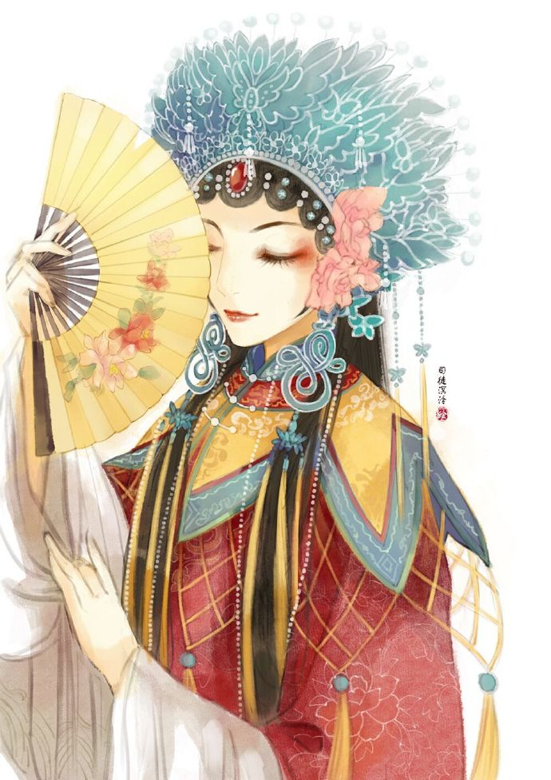
国
粹
BeiJing Opera
演讲者：蒋子韬
制作人：李和平，蒋子韬

Slide 2
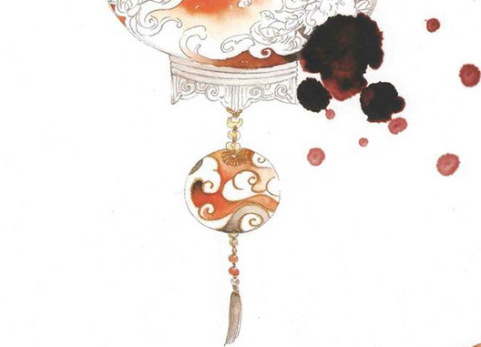
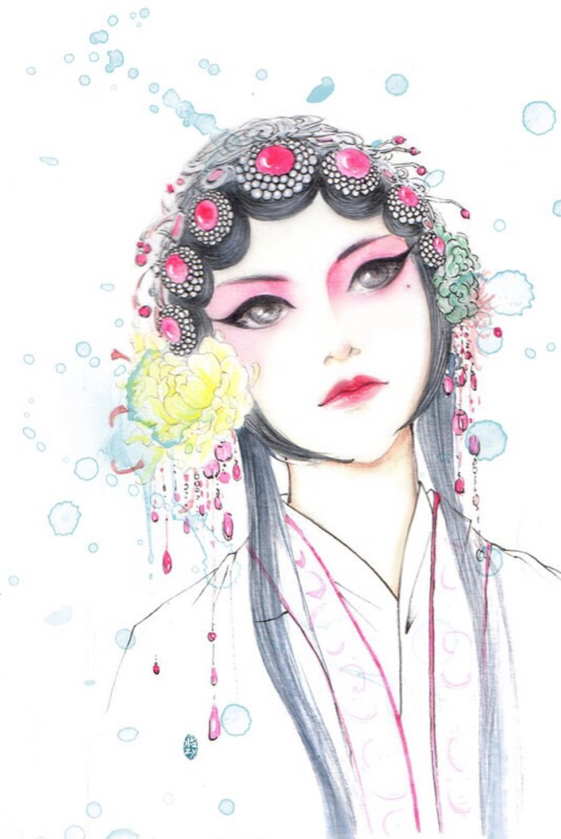
目
CONTENTS
录
1st
2nd
Basic aritstic means
Origins
3rd
4th
Facial Make-Up
Characters

Slide 3

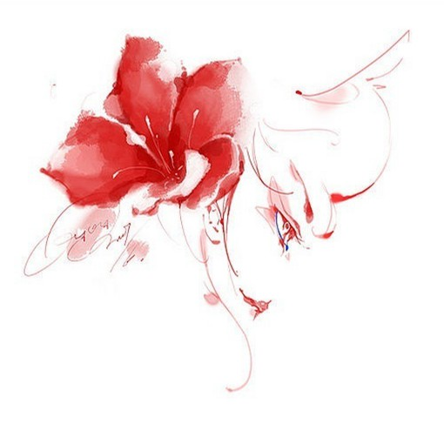
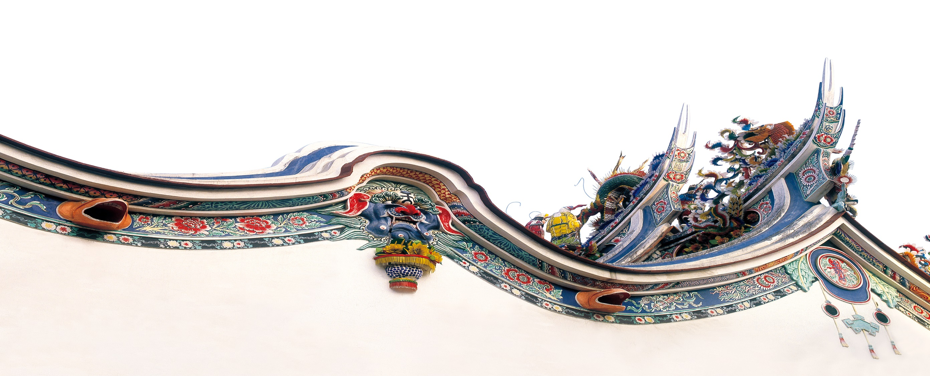
Origins
Beijing local drama
Traditional Chinese culture
Various performance elements
Beijing Opera evolved from a combination of Han opera, Xipi and folk music.
Beijing Opera has absorbed elements of traditional Chinese culture such as Confucianism, Taoist philosophy, Zen Buddhism, and so on.
Beijing Opera brings together various performance elements such as folk opera, Han drama, Qiong opera, and more.
起源
FILL IN THE TITLE HERE

Slide 4
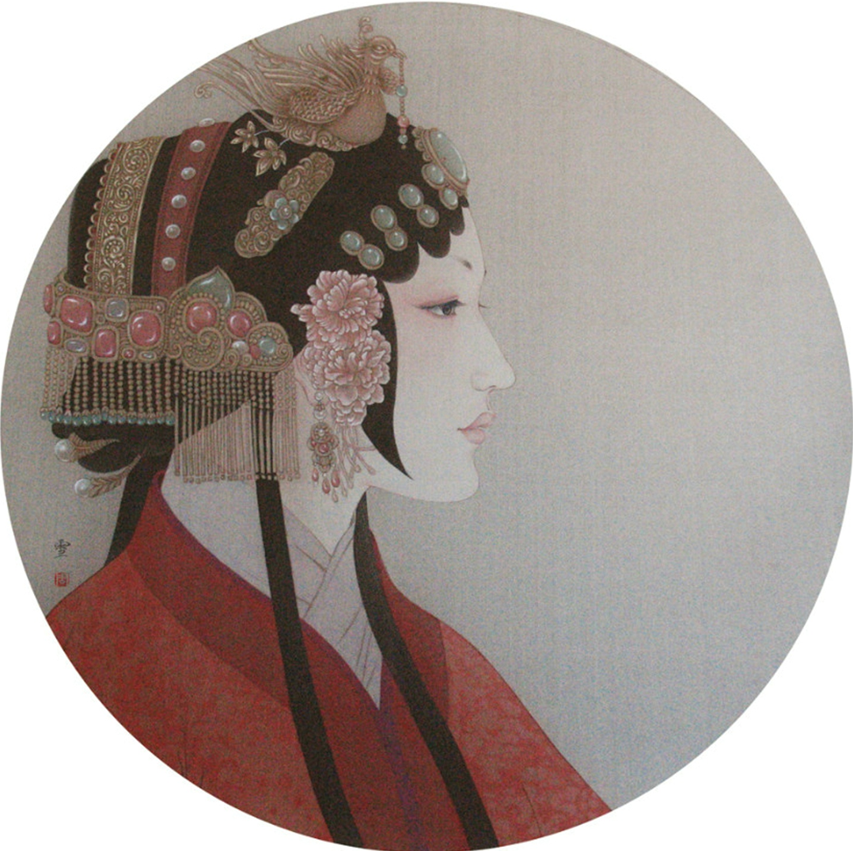
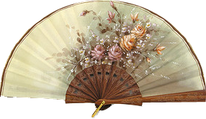
Basic artistic means
Performance skills
Singing style
a series of movements and combinations of dance, martial arts, and acting.
Xipi and Erhuang
Makeup and costumes
Dialogue
suitable for the character's gender, age, status, and emotional state.
Props
spoken dialogue that conveys the plot and emotional changes of the character.。
including swords, fans, whips, drums, and more.
形式
FILL IN THE TITLE HERE

Slide 5
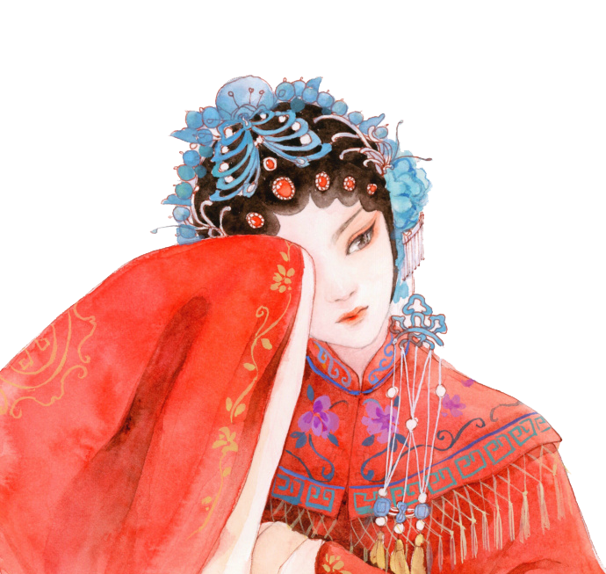
Characters
生
Sheng: Young or handsome male. Loyal, upright.
旦
Dan: Mature and beautiful woman. Gentle, kind.
净
Jing: Pure and beautiful female. Dignified, elegant.
人物
丑
Chou: Comical and funny character. Humorous, exaggerated.
FILL IN THE TITLE HERE

Slide 6
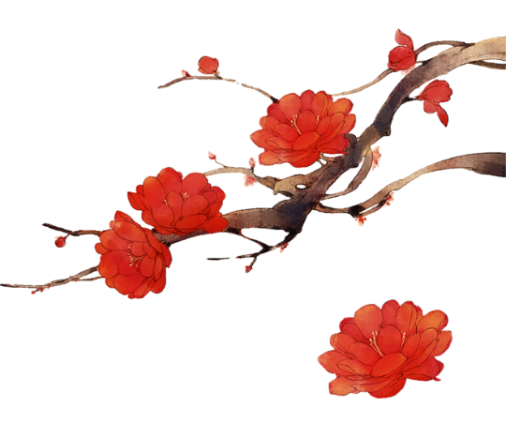
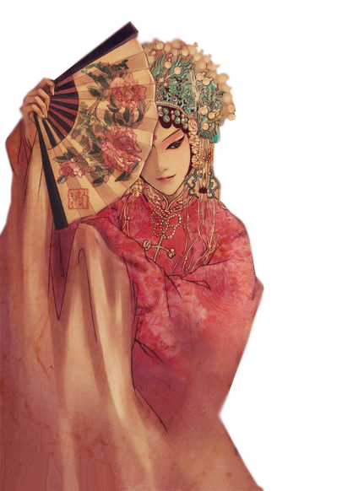
Facial Make-Up
Red Face
heroism loyalty,
justice integrity
Black Face
firmness decisiveness
dignity power
Yellow Face
cunningness treachery,
cruelty baseness
脸谱
FILL IN THE TITLE HERE

Slide 7

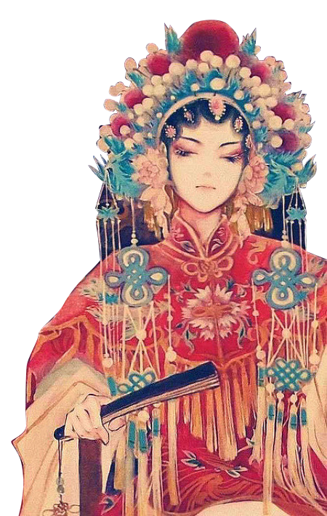
Facial Make-Up
Painted
Face
Represent youthfulness, vitality, cheerfulness, and happiness, usually appearing on male characters.
Blue-Green
Face
脸谱
Represent cleverness, wisdom, courage, and authority, usually appearing on noble characters.
FILL IN THE TITLE HERE
White
Face
Represent cunningness, treachery, cruelty, and baseness, usually appearing on villainous characters.

Slide 8
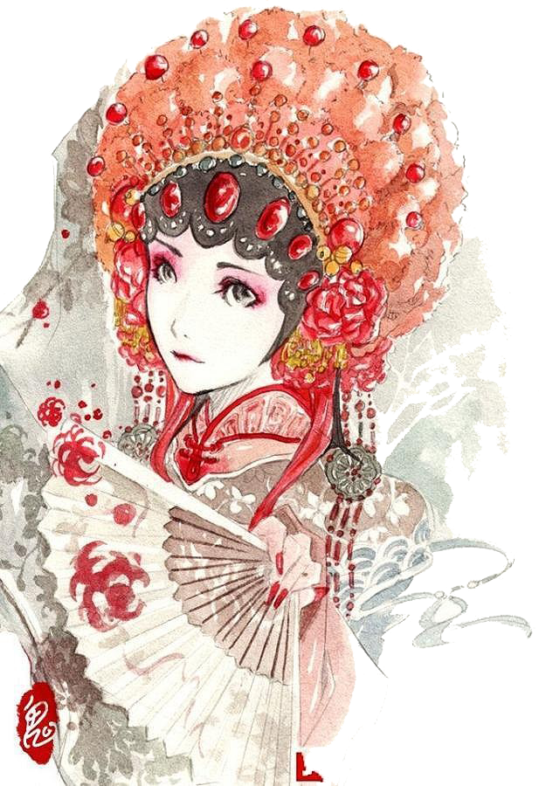
contemporary
significance
1. Inheriting and promoting Chinese culture.
2. Reflecting national and cultural confidence.
3. Promoting cultural exchanges between
China and foreign countries.
4. Enhancing national soft power.
意义
FILL IN THE TITLE HERE

Slide 9

完
结
京剧篇
Thank you for your patience!

